Slide 1

PES’s Modern College of Engineering, Shivajinagar, Pune-5. Department of Electronics and Telecommunication AY.: 2024-25, SEM-II
Think-Pair-Share Activity
Title: Network Administration: UTP
Cabling for PC to PC communication
Name of students:
SHIVAM GARAD(34527)
SHUBHAM GAVADE(34528)
ANAYA GOKHALE(34529)
NARESH GUNALE(34531)
ARYA KADAM(34534)
Name of the Course Incharge: Dr. M. A. Kango

Slide 2

PES’s Modern College of Engineering, Shivajinagar, pune-5. Department of Electronics and Telecommunication
Overview :
Introduction
Block Diagram / protocol format/ frame format
Explanation / Working etc.
Waveforms /figures (if any, optional)
Advantages
Limitations (if any, optional)
Applications
References ( total 8-10 slides)

Slide 3
Introduction
• Unshielded Twisted Pair (UTP) cables are widely used in networking for data communication.
• Commonly used in Ethernet networks for PC-to-PC communication.
• Involves direct or crossover cabling depending on the communication requirement.

Slide 4
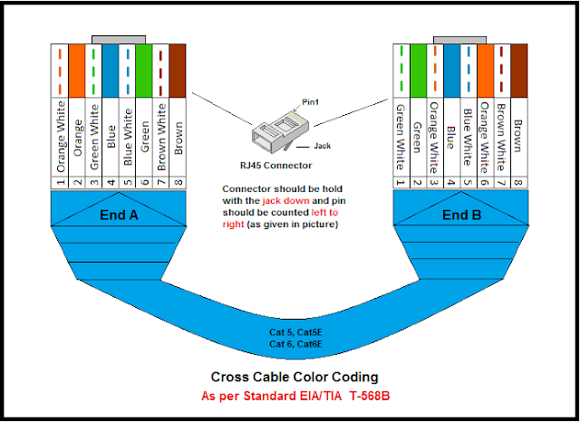
Block Diagram

Slide 5
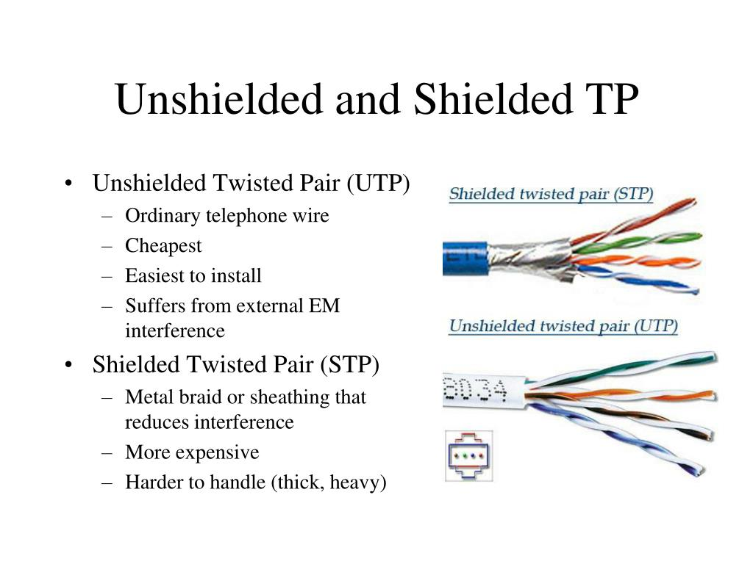

Slide 6
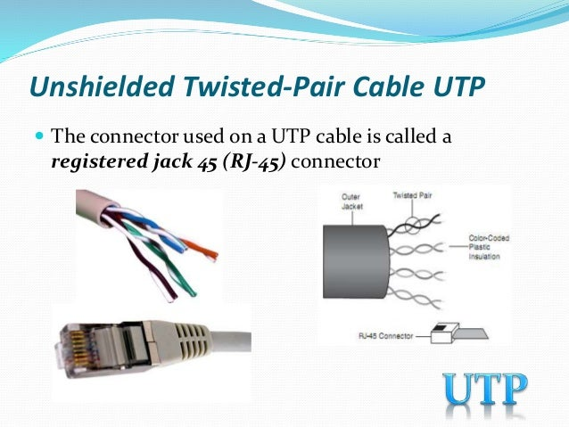
Working
• UTP cables use RJ-45 connectors for network connections.
• Uses crossover cable for direct PC-to-PC communication.
• Uses straight-through cable for PC-to-Switch communication.
• Data is transmitted in differential pairs to reduce interference.

Slide 7
Advantages
• Cost-effective and widely available.
• Easy to install and maintain.
• Supports high-speed data transfer.
• Compatible with standard Ethernet protocols.

Slide 8
Limitations
• Susceptible to electromagnetic interference (EMI).
• Limited transmission distance (~100 meters without repeaters).
• Lower security compared to fiber optics.

Slide 9
Applications
• Used in LAN (Local Area Networks) for office/home networks.
• Internet access via routers and modems.
• Industrial networking and IoT applications.

Slide 10
References
• IEEE 802.3 Ethernet Standard Documentation.
• Networking books such as 'Computer Networks' by Andrew S. Tanenbaum.
• Online resources from Cisco, CompTIA, and IEEE.

Slide 11
Thank You

